Slide 1
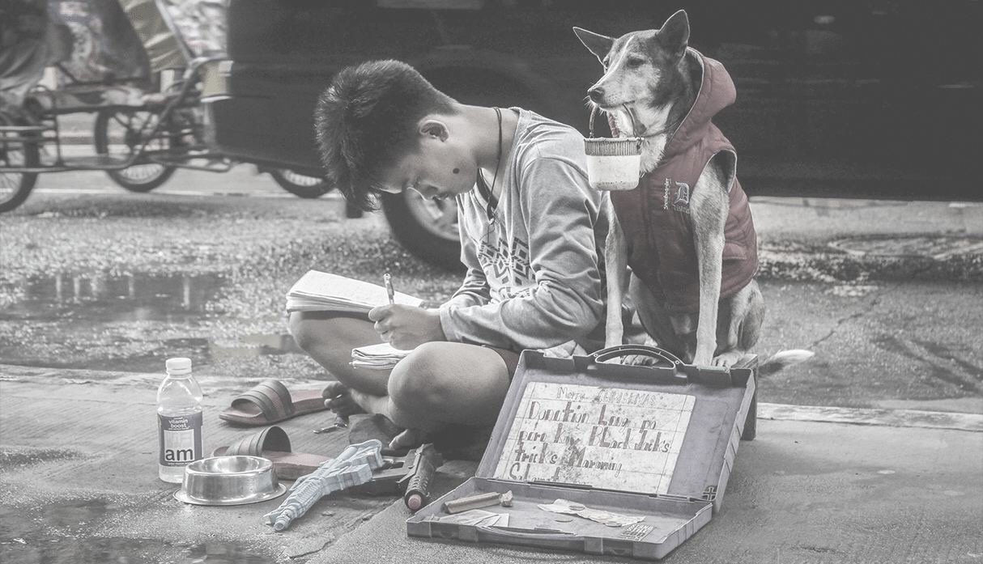

THE SAME TITLE USED IN THE TECHNICAL REPORT
Use the same title you
used in the report
Complete this slide
For the first deliverable

Slide 2

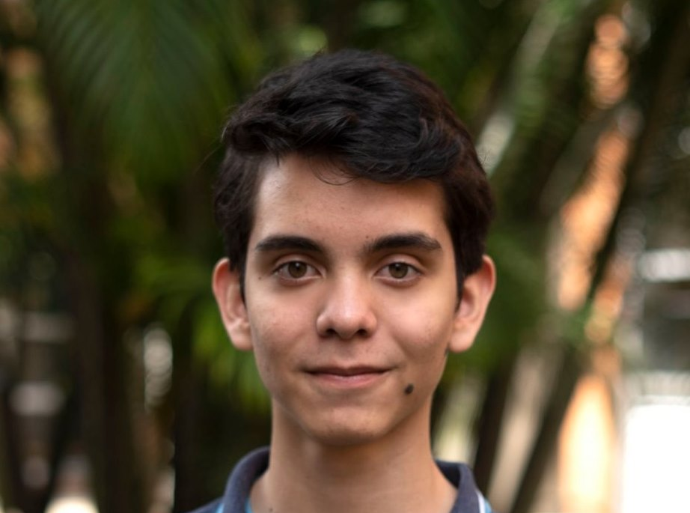

Team Presentation
Keep this title
Complete this slide
For the first deliverable
First author
Second author
Miguel Correa
Mauricio
Toro
Put a smiling picture and your name
Put a smiling picture and your name

Slide 3
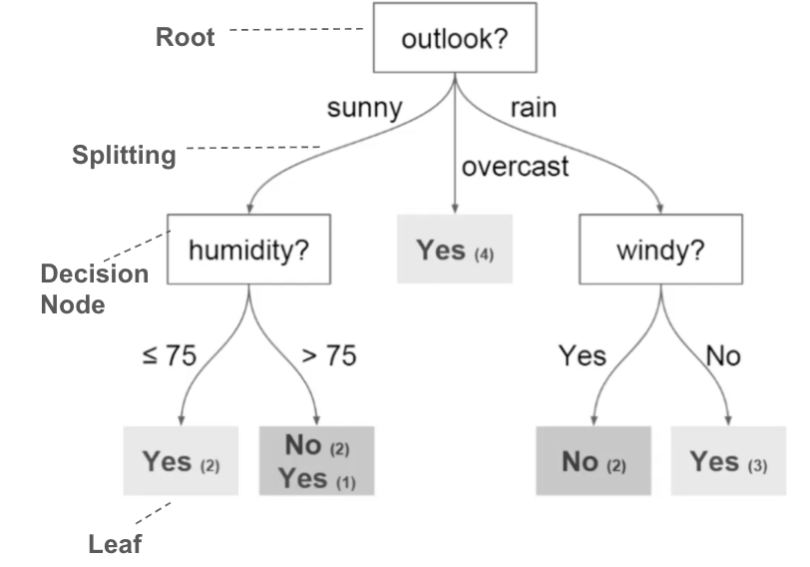
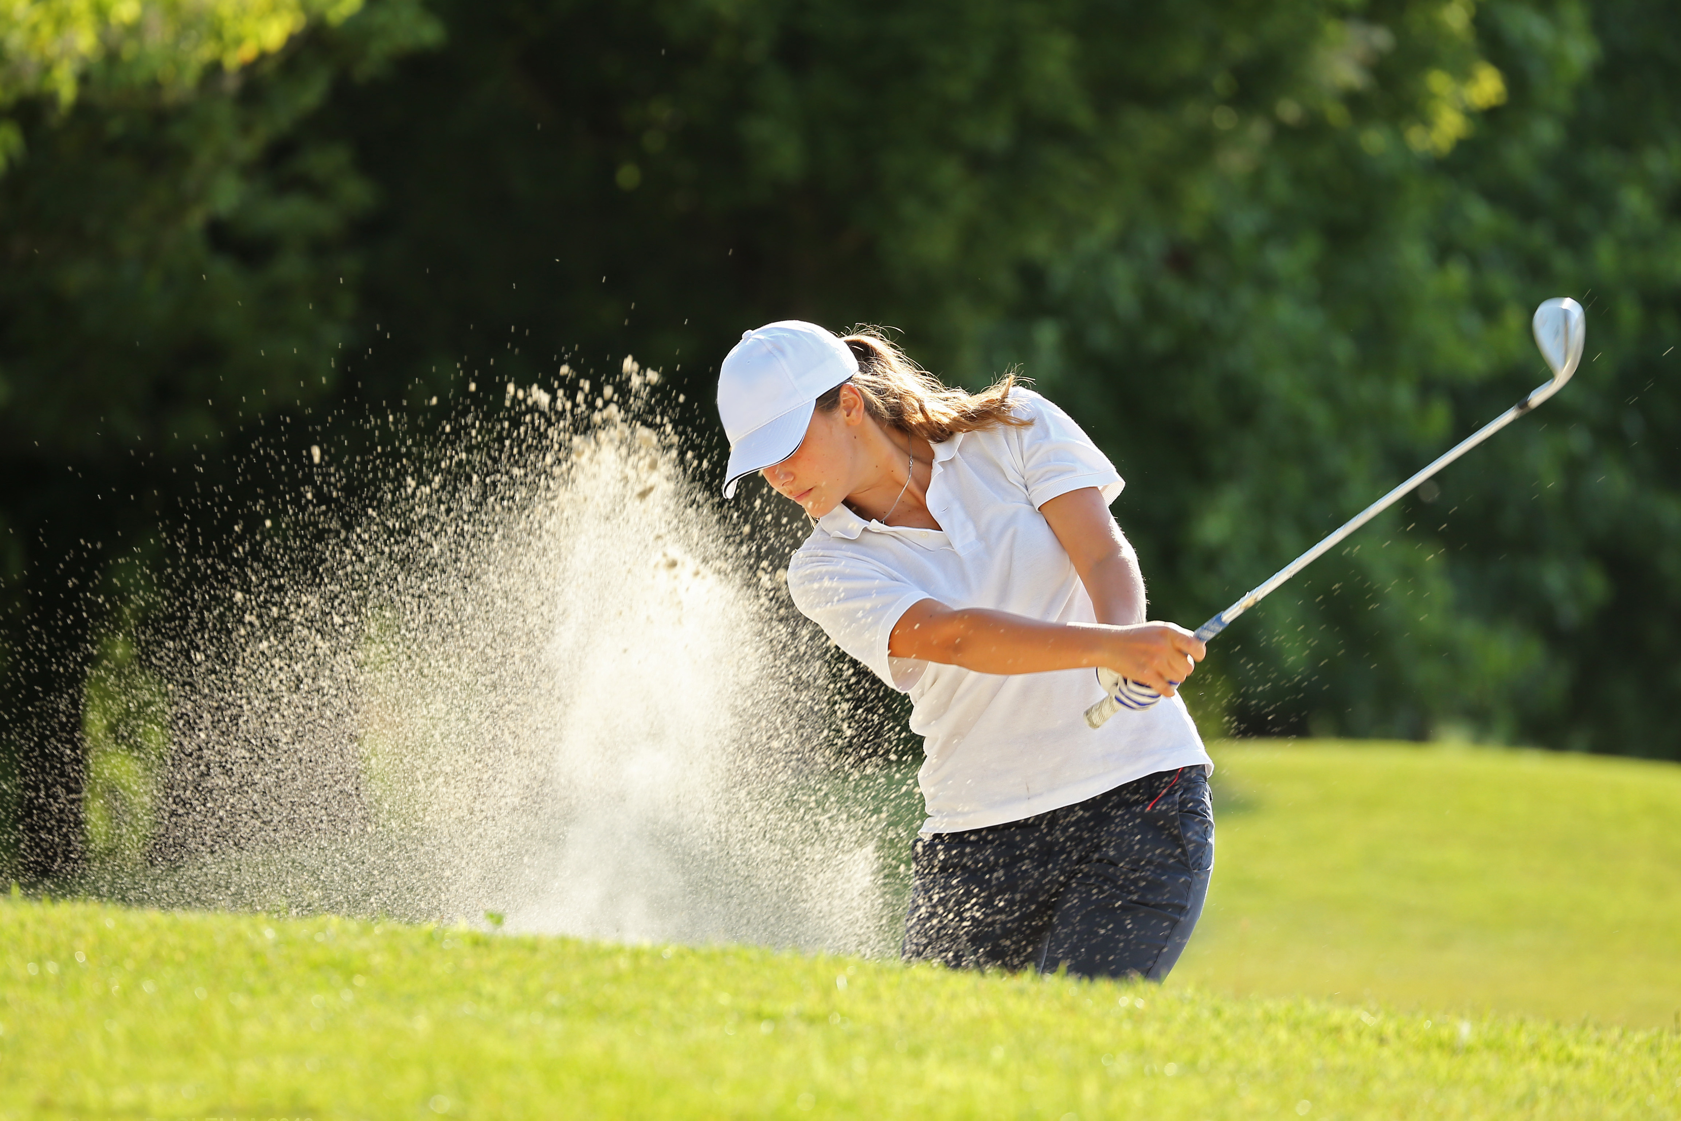
Complete this slide
For the second deliverable
Algorithm Design
Keep this title
Use vectorized figures to
explain the algorithm you designed, so
They are not pixeled like mine
Use these
Colors for
Your figures
Algorithm to build a binary decision tree using (In this semester, one could be CART, ID3, C4.5… please choose). In this example, we show a model to predict whether or not to play Golf, according to weather.
Include a HD picture related to the example that you modeled in the decision tree
Explain the figures in your
own words

Slide 4
Node Splitting
Keep this title
Use vectorized figures to
explain the algorithm you designed
Use these
Colors for
Your figures
Complete this slide
For the second deliverable
As an example, this split is based on the condition “income == 10.”
For this case, left Gini impurity is 0.44, right Gini impurity is 0.32, and weigthed Gini impurity is 0.37.
As an example, this split is based on the condition “stratum == 4.”
For this case, left Gini impurity is 0.44, right Gini impurity is 0.5, and weigthed Gini impurity is 0.45.
Explain the figures in your
own words

Slide 5

Complete this slide
For the third deliverable
Algorithm Complexity
Keep this title
Create the table in Powerpoint. Do not copy pixelated screenshots from the technical report please!
 | Time Complexity | Memory Complexity
Training the model | O(N²*M*2^{M}) | O(N*M*2^{M})
Testing the Model | O(N*M) | O(1)
Time and memory complexity of the (In this semester, one could be CART, ID3, C4.5… please choose) algorithm. (Please explain what do N and M mean in this problem. PLEASE DO IT!
Explain the tables in your
own words
Include another HD picture related to the example that you modeled in the decision tree

Slide 6
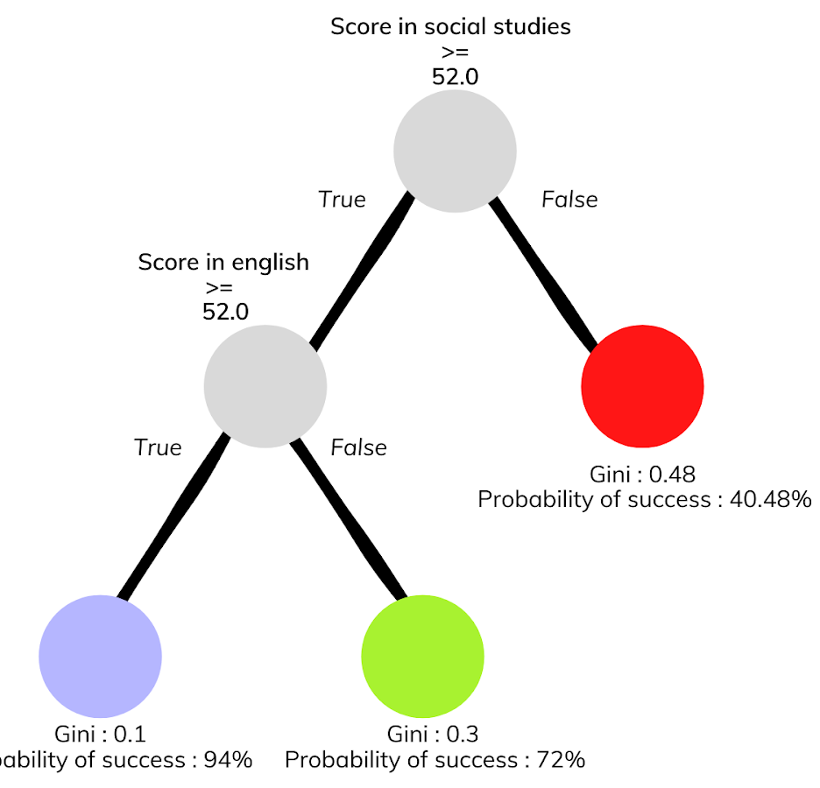



Complete this slide
For the third deliverable
Decision-Tree Model
Keep this title
Create the Figure in Powerpoint. Do not copy pixelated screenshots from the technical report please!
Most Relevant Features
Social Studies
English
Gender
A binary decision tree to predict Saber Pro scores based on the results of Saber 11. Violet nodes represent those with a high probability of success, green medium probability and red a low probability of success.
Use an icon for each feature!
Is it ethical to make a model that predicts academic success based on gender?
Explain the Figures in your
own words

Slide 7
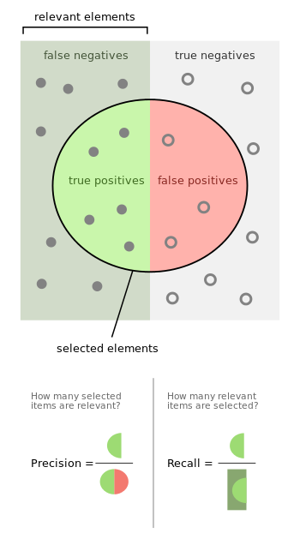
Complete this slide
For the third deliverable
Evaluation Metrics
Keep this title
Use vectorized figures to
explain the algorithm the evaluation metrics, so they are not pixeled like mines
Use these
Colors for
Your figures
Explain Accuracy too…
In the same manner
If possible, avoid equations for simple concepts that can be
explained through diagrams

Slide 8
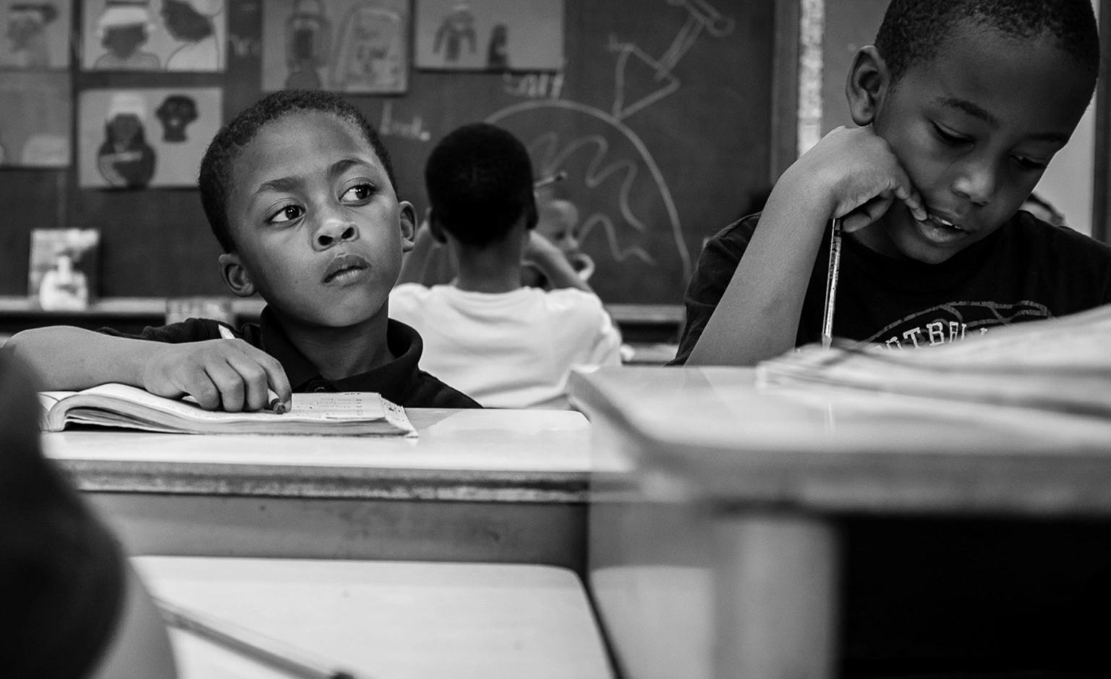
Complete this slide
For the third deliverable
Evaluation Metrics
Keep this title
Create the table in Powerpoint. Do not copy pixelated screenshots from the technical report please!
 | Training data set | Testing data set
Accuracy | 0.8 | 0.62
Precision | 0.6 | 0.55
Recall | 0.76 | 0.61
Evaluation metrics using a training dataset of 135,000 students and test dataset of 45,000 students.
Include another HD picture related to the example that you modeled in the decision tree
Explain the tables in your
own words

Slide 9


Complete this slide
For the third deliverable
Time and Memory Consumption
Keep this title
Create the plots in Excel. Do not copy pixelated screenshots from the technical report please!
Time Consumption
Memory Consumption

Slide 10
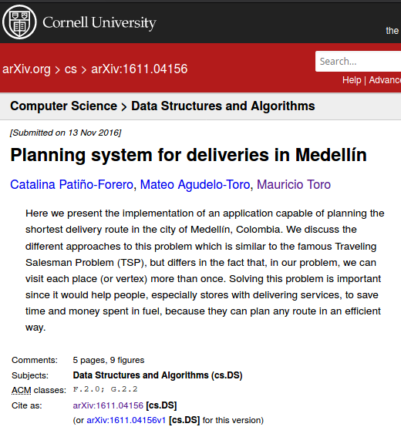
Complete this slide
For the third deliverable
Report Accepted on arXiv
Keep this title
Include the citation of the report in arXiv and link
C. Patiño-Forero, M. Agudelo-Toro, and M. Toro. Planning system for deliveries in Medellín. ArXiv e-prints, Nov. 2016. Available at: https://arxiv.org/abs/1611.04156
Include a screenshot

Slide 11
Complete this slide
For the third deliverable
Say thank you for listening!
THANK YOU!

